Slide 1


Using a prevention cascade to understand the impact of interventions on the voluntary medical male circumcision programme in South Africa
Sarah Chan ¹, Saul Johnson ¹, Collen Bonnecwe ², Dayanund Loykissoonlal ², Maaya Sundaram ³, Sarah Magni ¹
¹Genesis Analytics; ²Department of Health; ³Bill and Melinda Gates Foundation

Slide 2
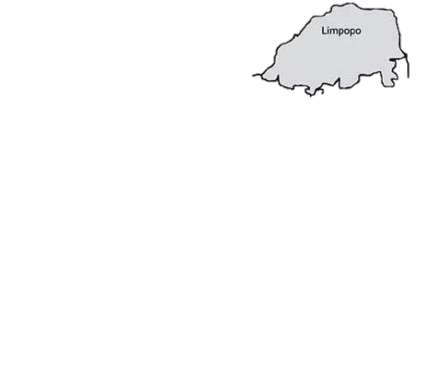
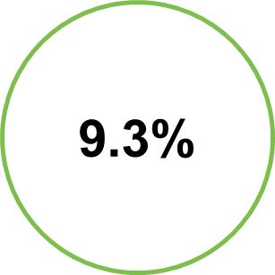
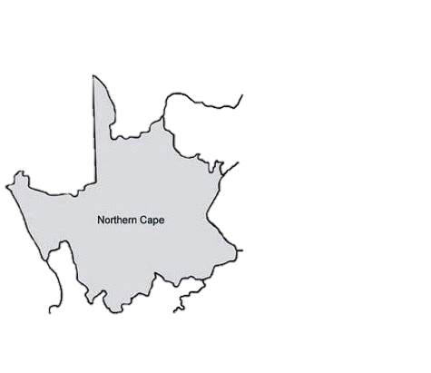
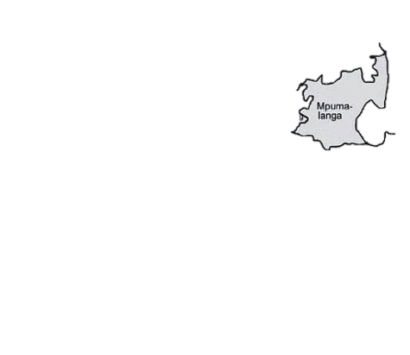
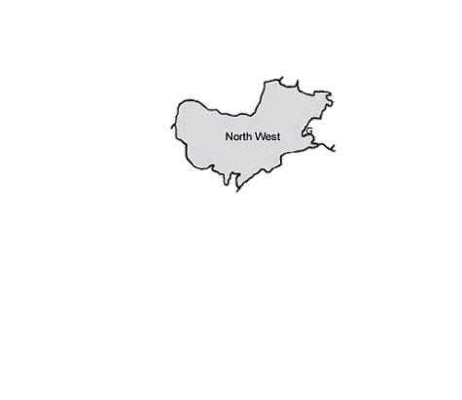
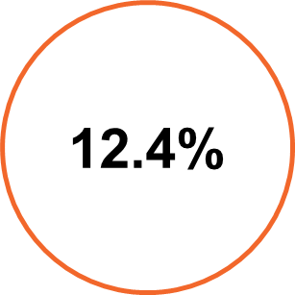

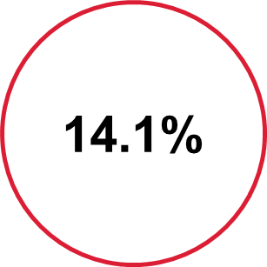
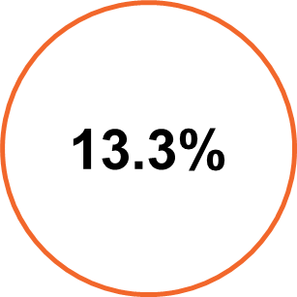

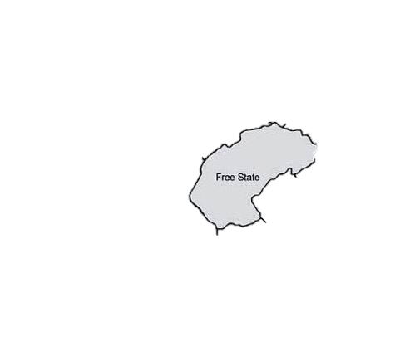
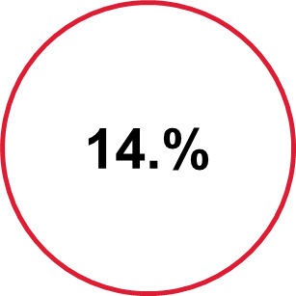
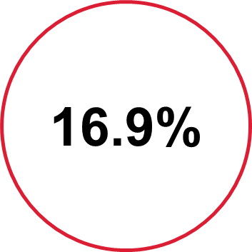
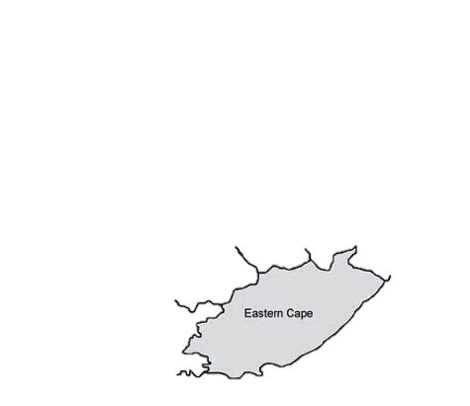
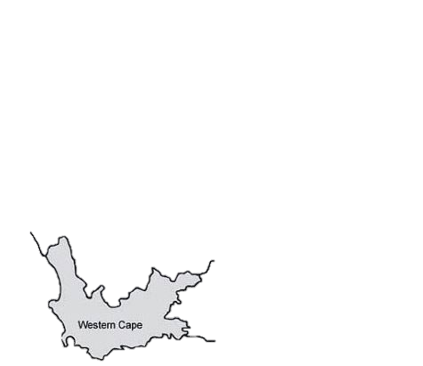
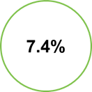
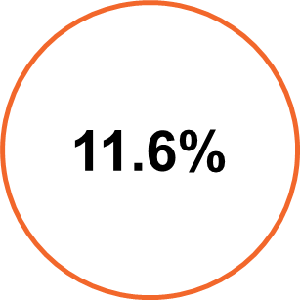
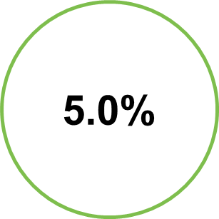
HIV prevalence in South Africa is 12.2% (2012)
HIV prevalence in South Africa varies between provinces
HSRC 2012
Notes:
South Africa has one of the most severe HIV epidemics in the world, with an estimated 7 million people infected with HIV, and around 300 000 new infections every year.
Medical male circumcision has been shown to reduce the risk of HIV transmission from women to men by 60%.
http://aidsinfo.unaids.org/. Accessed 6 February 2017
Auvert B, Taljaard D, Lagarde E, et al. Randomized, controlled intervention trial of male circumcision for reduction of HIV infection risk: the ANRS 1265 trial. PLoS Med.2005;2:e298.

Slide 3
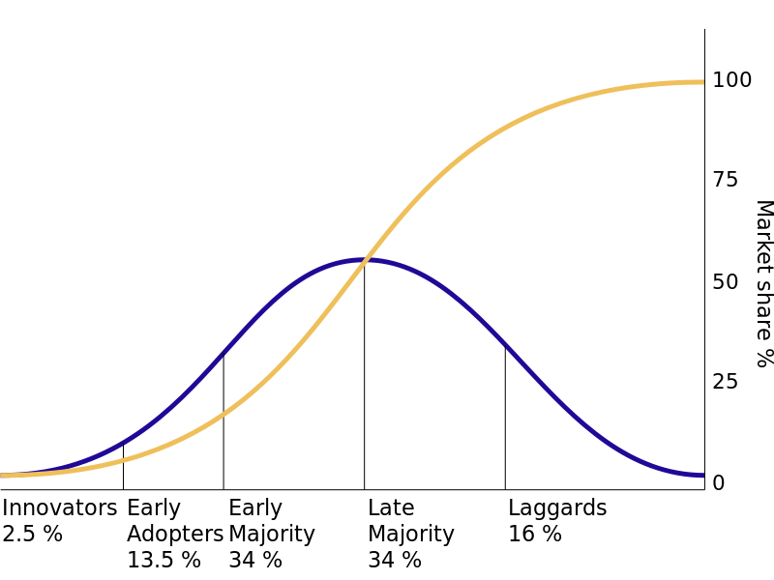
Circumcision follows a diffusion of innovation curve
Notes:
The late majority are among the last to adopt an innovation. These individuals may be deeply sceptical about innovation and tend to have low opinion leadership. They generally have below average social status and are in contact both with the early majority and others in the late majority.
Laggards are the last to adopt an innovation. These individuals show little or no opinion leadership and typically have an aversion to change agents. Laggards tend to be focused on "traditions" and constitute the oldest group, only in contact with family and close friends.
Initial demand-creation campaigns, generally using mass media, sought to convince the early majority that medical circumcision was widely accepted and was the right thing to do.
However, MMC is unlike most consumer products as it is a surgical procedure and very personal.
Therefore, later demand-creation tactics must utilise a variety of communication channels, particularly person-to-person dialogue. Demand-creation tactics should also reinforce an idea in the consumer’s mind, which is where mass media such as television and radio play a part in sustaining awareness.

Slide 4
MMC targets are not being met in South Africa
South Africa aimed to reach 80% of males between the ages of 15-49 with MMC by the end of 2016
  This amounts to 4.3 million males
The target for the 2017/2018 year is 650,000 nationally
2.5 million circumcisions over the next five years
Total population | 55m
Male population 15-49 | 14.8m
HIV prevalence 15-49 | 18%
MC prevalence | 46%
2.86m
Total MMCs
up to end FY16/17
DHIS 15-49: 554 300
Private (10-49) and partners (10-14): 2 303 41
Source: NDoH, 2016.
Notes:
Medical male circumcision has been shown to reduce the risk of HIV transmission from women to men by 60%. In 2010, South Africa launched medical male circumcision (MMC) programme, with the intention of circumcising 4.3 million men by 2016. However, the rates of circumcision having plateaued over the last 2-3 years.
Talk about age pivot

Slide 5



Used cascade model to review MMC programme
Literature and document review
MMC statistics
Journal articles
PEPFAR partners demand creation documents
National key informant interviews
PEPFAR implementation partners
General Practitioners (GPs)
District and provincial level interviews
135 interviews were conducted in 19 districts in Gauteng, Kwa-Zulu Natal, and Mpumalanga
Interviewees included: MMC programme managers, District HAST Coordinators, demand generation outreach workers (e.g. PHCWBOTs, traditional mobilisers), ACSM managers, clinic-based NGO service delivery partners
Notes:
We used a cascade model to review of the MMC programme in South Africa and understand where the programme was lacking in focus, and where it could be strengthened.
The review included examining relevant literature from implementing partners in Sub-Saharan Africa, as well as interviewing key informants involved in the South African programme.
We undertook visits to 19 high-burden districts across three provinces, to understand how the programme is being implemented, and identify areas of best practice that could be implemented across the country.

Slide 6
2.5 million
Target: number of uncircumcised men being targeted
Reach: demand creation activities
Knowledge: number of men who know about the benefits of MMC
Supply: availability of resources and commodities
Intention: uncircumcised men who intend to take up MMC
Follow-up: recovery time, condom use & counselling
Effectiveness: uptake of MMC services
Notes:
Using the cascade, we were able to demonstrate that the issue of flat-lining uptake has to do with overcoming barriers, i.e. intention. This cascade also helps to demonstrate that each step requires substantial thought and evidence to determine whether the intended targets are being reached, and whether evidence-based approaches are being used. The cascade maps out where the biggest areas for impact on the South African circumcision programme are, based on the population at risk, so that implementers, i.e. the National Department of Health, can bolster resources, which are often limited.
NSP 2017-2022 | cumulative over 2016-2021
IPSOS 2015 | Exposure to Brothers for Life on TV
McCann 2015 | Men who know that circumcisions reduces risk of HIV
NCS 2012 | Defined as having "a facility/service available in your community to do Medical Male Circumcision?"
NCS 2012 | Defined as number saying they "definitely will" or "probably will" get medically circumcised in the next 12 months (restricted to those not circumcised)
NCS 2012 | Defined as number of men reporting having been circumicsed by a medical doctor / estimated based on 281k progress at 6 weeks
NCS 2012 | Defined as number of men who had MMC who were told to "Wait to have sex until the wound is completely healed"

Slide 7
    Knowledge of MMC benefits are quite high, but there is still a need to reinforce these messages
Notes:
Especially as young men head towards sexual maturity. Mass media campaigns are still important

Slide 8
Men know the MMC health benefits, including reducing the risk of HIV and other STIs
Notes:
Facts: The use of facts about the health benefits of MMC remains an important aspect of messaging. However, facts alone will not persuade the later majority and laggard population and others who experience particular barriers to circumcision.

Slide 9
    Men need to move from knowledge to intention
Notes:
Strategies here include targeting female partners, focusing on aspirations and male responsibilities

Slide 10

To help men develop intention, messaging has engaged women and reframed masculinity
Notes:
Reframing masculinity: Both celebrities and everyday role models are used to provide testimonials and support for MMC. Celebrity testimonials may be effective in encouraging the younger half of the target age group as conformity may still play a part in their decision making. For older men, a focus on being a positive role model for future generations may be more effective.
Engaging women: “ZING” This features a group of women in a beauty salon chatting about their man getting an “upgrade”. The advert outlines health benefits of MMC for women, highlights the six-week healing period, promotes the use of condoms, and expresses women’s preference for a circumcised penis. The advert prompted women to discuss circumcision among themselves and to encourage their partners to get the upgrade.

Slide 11
    In many men, we need to move them from intention to action
Notes:
This often includes addressing the barriers to MMC. In the area social mobilisers in the community have a critical role. But they need to be well trained and have good resources

Slide 12













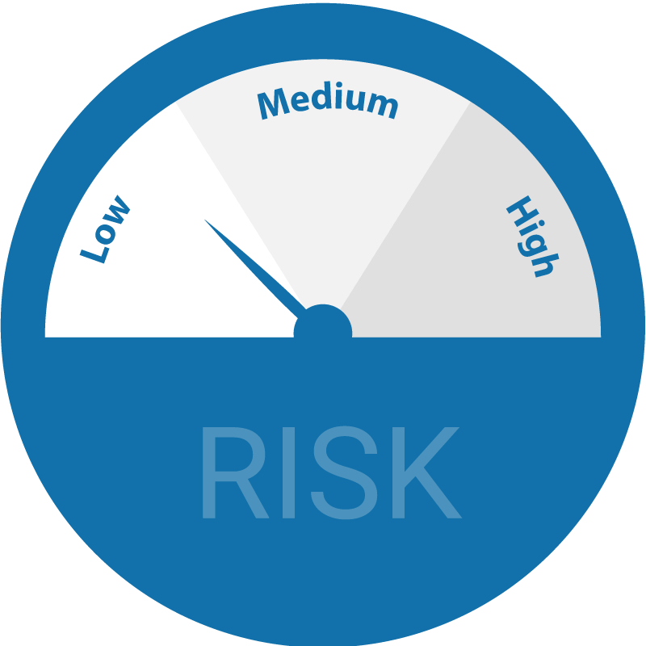



Older men experience particular barriers which prevent them from MMC even with intention
Barriers which can be responded to
Barriers that are more difficult to respond to
Getting time off work for MMC and loss of wages
Concerns about disposal of the foreskin (for example, suspicion about it being sold)
Anxiety about the response of family, friends, colleagues and others
Perceptions that health facilities are for women
Lack of partner support
Low risk perception
Inconvenient service hours
Female service providers.
Post-procedure sexual abstinence
Fear of pain
Anxiety about HIV testing
Perception of poor service delivery
Seasonal demand for MMC
Cultural and religious beliefs
1. Compiled from interviews and from Health Communication Capacity Collaborative. (2016). Technical Considerations for Demand Generation for Voluntary Medical Male Circumcision in the Context of the Age Pivot
Notes:
Pick a few examples, don’t go through them all.

Slide 13
Understanding the visualisation of programme data
1
    Cascades can be useful to highlight where the gaps in the programme are or are likely to be.
2
    There are limitations – data from different years and different sources, with different denominators. This is not an exercise for purists.
3
    Ideally implementers should decide up front if they want to use this approach, and then ensure that the relevant indicators are collected in a robust way.
4
    Cascades are already being used for treatment (tracking 90:90:90 progress). However, we need to find ways to make them user-friendly.
Notes:
There is an imperative to increase uptake of MMC as a cornerstone of the HIV prevention response in South Africa. However, doing this will require a comprehensive and integrated approach, which considers a combination of behavioural, social and facility-led interventions. Using the HIV prevention cascade can be useful to examine the areas where men may “fall off” the cascade, and how this can be prevented.

Slide 14
Thank you
Questions?

