Slide 1


COMMITMENT CARD
Want to lower your risk of getting HIV/AIDS, STIs and cancer?
Yes, I’m responsible
Book your circumcision at reception and keep this card as your booking reminder
No, I
don’t care
I will visit the clinic on: DD | MM | 20YY
My name is:
My signature:

Slide 2
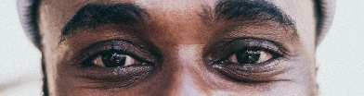


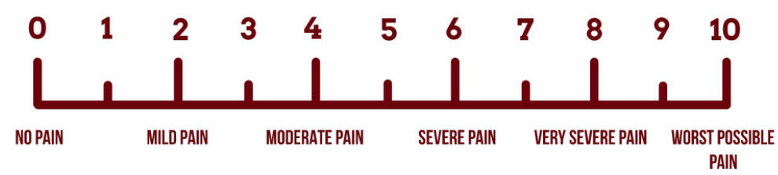


THINGS YOU
NEED TO DO:
Don’t miss out on the BENEFITS of VMMC
1. Book an appointment
today; fill in booking date
Safe
Quick
2. Take a half-day off work on the day of circumcision
Free
Once-off
Lowers risk of HIV, STIs and partner cervical cancer
3. Eat breakfast on
the day of the circumcision
Improves sexual performance
Day 1-3 post-operative pain scale
4. Come back to the clinic
2 days later for a check-up

Slide 3
KARETE YA BOITLAMO
Re batla ho fokotsa monyetla wa kotsi ya hao wa ho fumana HIV/AIDS, mafu a thobalano (di-STD) le kankere?
E, ke a ikarabella
Beheletsa lebollo la hao clinic mme o boloke karete ena jwalo ka kgopotso ya peheletso ya hao mahala
Tjhe, ha
ke tsotelle
Ke tla etela tleliniki ka la: LL | KK | SSSS
Lebitso la ka ke:
Tshaeno:
Notes:
seSotho front

Slide 4
DINTHO TSEO O
LOKELANG HO DI ETSA:
Se ke wa fetwa ke DIHLAPISO TSA VMMC
1. Beheletsa apoentemente
ho VMMC Clinic kajeno
E bolokehile
E a potlaka
2. Nka letsatsi la ho lofa mosebetsing
ka letsatsi la ho ya bololla
Ke mahala
E etswa ha nngwe
E fokotsa monyetla wa tshwawetso ya HIV, di-STI le kankere ya molomo wa popelo ho molekane wa hao
3. Eja dijo tsa hoseng ka
letsatsi la ho ya bolla
E ntlafatsa tshebetso ya tsa thobalano
Sekala sa tekanyo ya bohloko kamora opareishene Matsatsing a 1-3
4. Kgutlela tleliniking
Matsatsing a 2 ha morao bakeng sa tlhahlobo
Notes:
seSotho back
Take a half-day off work on the day of circumcision

Slide 5
IKHADI LOKUZIBOPHEZELA
Ufuna ukunciphisa ingcuphe yakho yokungenwa yi-HIV/AIDS, ama-STI nomdlavuza?
Yebo, ngizimisele
Bhukha ukuze usokwe clinic futhi ugcine leli khadi njengesikhumbuzo sakho se-aphoyintimenti yamahhala
Cha,
anginandaba
Ngizovakashela umtholampilo ngo-: DD | MM | YYYY
Igama lami ngingu-:
Isiginesha yami:
Notes:
isiZulu front

Slide 6
IZINTO
OKUFANELE UZENZE:
Ungaphuthelwa YIZINZUZO ze-MMC
1. Yenza i-aphoyintimenti
e-VMMC Clinic namuhla
Iphephile
Iyashesha
2. Thatha i-off emsebenzini
ngosuku lokusoka
Imahhala
Yenziwa kanye
Inciphisa izingcuphe ze-HIV, ama-STI nomdlavuza womlomo wesibeletho kuphathina wakho
3. Yidla ibhulekifasi elinomsoco
ngosuku lokusoka
Ithuthukisa ezocansi
Isikali sezinhlungu soSuku 1-3 ngemuva kokuhlinzwa
4. Buyela emtholampilo
izinsuku ezi-2 kamuva uyohlolwa
Notes:
isiZulu back

