Slide 1

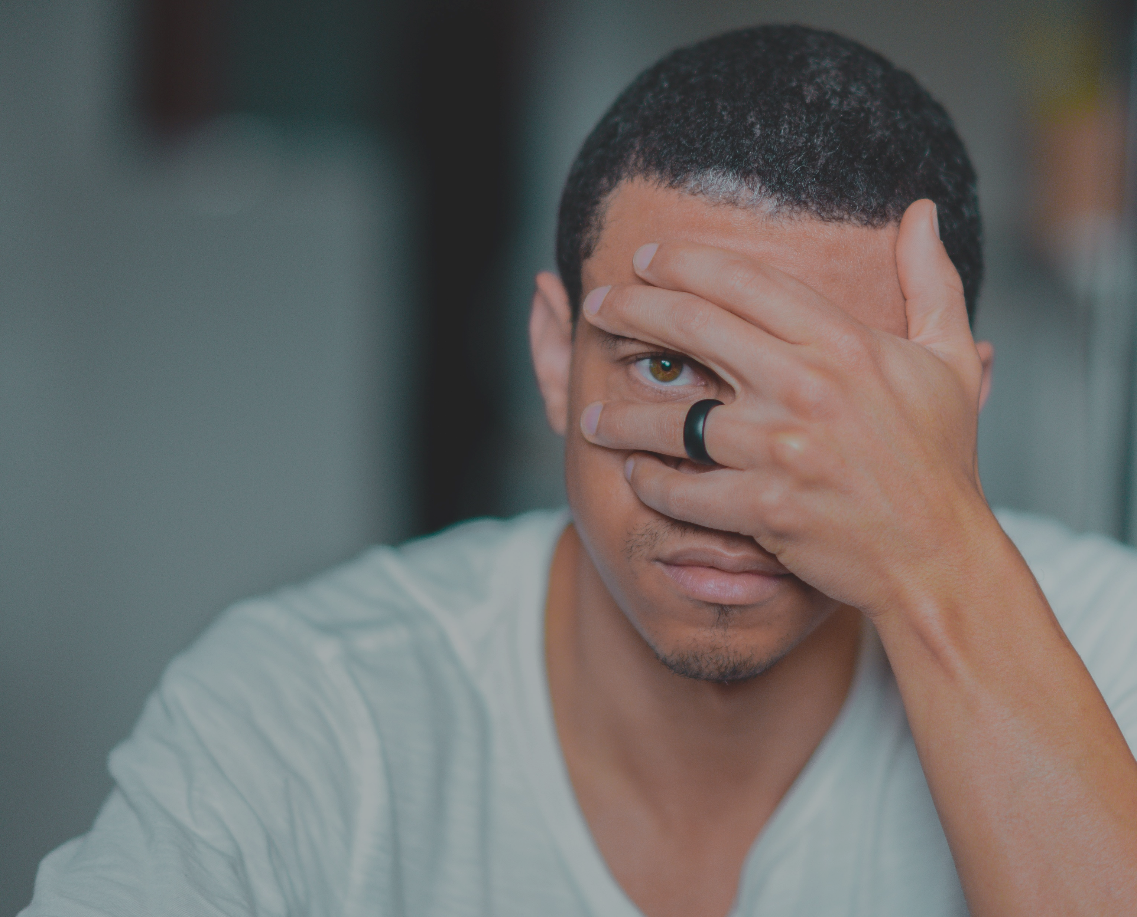



  Take back control of your health!
Medical Male Circumcision
Worried about
STDs & HIV?
to reduce your chance of getting HIV from your female partner by 60%
choose
Medical Male
Circumcision
Once-off
Free
Safe
  Follow the footsteps to the clinic

Slide 2
  Nka taolo ya bophelo ba hao bo botle!
Lebollo la Banna la Ngakeng
Na o ngongorehile Mabapi le Mafu a thobalano (di-std) le HIV?
fokotsa monyetla oa ho fumana HIV -60%
Lebollo la Banna la Ngakeng
Le a potlaka
Ke mahala
Le bolokehile
  Latela mehato e isang tleliniking

Slide 3

Once-off
Free
Safe
Medical Male Circumcision
You’ll be done in
30
min
We trust Medical Male Circumcision & know it is safe. So, you can too.
Ask us
about it today!
Once-off
Free
Safe
  Follow the footsteps to the clinic

Slide 4
  Nka taolo ya bophelo ba hao bo botle!
Lebollo la Banna la Ngakeng
O tla be o qetile ka nako ya metsotso e
30
min
Bua le mooki wa hao ka sena!
O matsohong
a bolokehileng!
Le a potlaka
Ke mahala
Le bolokehile
  Latela mehato e isang tleliniking

Slide 5




Le a potlaka
Ke mahala
Le bolokehile
Lebollo la Banna la Ngakeng
O tla be o qetile ka nako ya metsotso e
30
Bua le mooki wa hao ka sena!
O matsohong
a bolokehileng!
Le a potlaka
Ke mahala
Le bolokehile
  Latela mehato e isang tleliniking

Slide 6

  Let’s prevent HIV before it’s too late!
Medical Male Circumcision
Mom, are you worried about your son’s sexual health?
Safe
Free
Once-off
Medical Male Circumcision reduces a man’s chance of getting HIV & STIs
  Ask a nurse or doctor about it today!

Slide 7

  Take back control of your health!
Medical Male Circumcision
Safe
Free
Once-off
I want to be protected against HIV & STIs.
What about you?
4.4 million South African men
are proof VMMC is the right choice!
  Follow the footsteps to the clinic

Slide 8
  Nka taolo ya bophelo ba hao bo botle!
Lebollo la Banna la Ngakeng
Le bolokehile
Ke mahala
Le a potlaka
Ke nkile boikarabello ka bophelo ba ka bo botle!
Banna ba dimilione tse 4.4 ke bopaki ba hore ke kgetho e ntle!
  Latela mehato e isang tleliniking

Slide 9

Once-off
Free
Safe
Medical Male Circumcision
Let us improve
the health of men in South Africa
Hey!
Do you want to know how to get circumcised – safely, right here?
I support preventative health.
Once-off
Free
Safe
  Prevention is better than cure. Advocate for VMMC.

